Slide 1

Sports Analytics SIG (9/3)
WELCOME!

Slide 2
Calvin Skalla
From Jefferson, IA; about 45 miles west of Ames
Senior at Iowa, majoring in Statistics & Mathematics with minors in Philosophy and Sport & Recreation Management
Head Women's Basketball Manager plus a member of a handful of student organizations

Slide 3
Luke Statler
From O'Fallon, MO; about 30 miles west of St. Louis
Senior at Iowa, majoring in Informatics and Sports & Recreation Management
Baseball Data Analyst

Slide 4
Reed Zahradnik
From Marion, Iowa – Went to Linn-Mar High School (for the local people)
Junior at Iowa, majoring in Business Analytics with minors in Statistics and Sport and Recreation Management
Baseball Data Analyst

Slide 5
Networking Activity
Introduce
Name, major, and year at Iowa, favorite sports team(s)
Transition
Previous knowledge of sports analytics and what sports you're interested in
Conclude
Goals and reasons why you want to further your knowledge of sports analytics

Slide 6
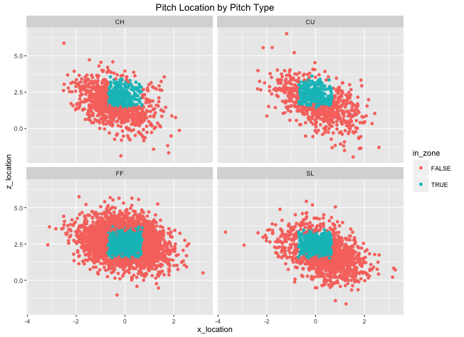
About the club last Year
Small group that started to learn the foundations for using R and its applications in sport
Gathered data from the internet and made helpful visualizations

Slide 7
Ideas for this Year
Introduce articles, Twitter icons, or video clips that demonstrate an alternative thinking on sports that we can then discuss as a group what we thought individually
Import and manipulate data to make insightful visualizations. Learn how to build machine learning models to predict or classify a desired variable.
Create a project to either predict the amount of a continuous variable or classify a discrete variable based off various features.

Slide 8
Our Favorite twitter follows
Calvin
@SharpFootball
@chuurveg
Luke
@DrivelineBB
@UIBASEManagers
Reed
@BenBaldwin
@Open_Source_FB
@DarenW

Slide 9
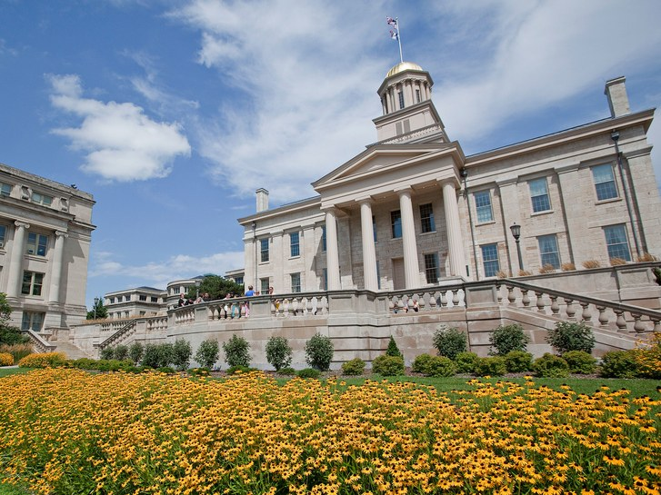
Project Ideas?

